Slide 1
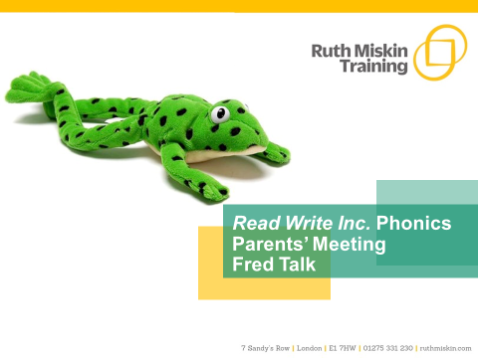

Tuesday 30th April 2024
Meeting 2.30pm
Welcome! Thank you for coming along.

Slide 2
What is phonics?
Sounds/Phonemes- sounds are merged together to form words
Graphemes- a name for the letters we use to write the sound e.g. ‘ay’.
Red words- High frequency ‘common words’ such as the, we, my, me, would, there etc.
Notes:
All words are made up of individual sounds. These sounds are merged together to form words.
e.g. in ‘mat’ we have the sounds ‘m’, ‘a’, ‘t’, ship – ‘sh’, ‘i’, ‘p’.
Click A grapheme is another name for the letters we use to write the sound. The spelling of that sound on the page.
Phonics is the method of teaching reading through the identification of sounds and graphemes.
The new National Curriculum ensures that all children are taught Phonics systematically.
This gives your children the tools to read any word.

Slide 3

Speed Sounds Set 1
Notes:
Remember that:
- Children need to know sounds – not letter names – to read words.
- We pronounce the sounds clearly, using pure sounds (‘m’ not’ muh’, ’s’ not ‘suh’, etc.) so that your child will be able to blend the sounds together to make words more easily.

Slide 4

Speed Sounds Set 2
Notes:
Set 2 sounds are shaded. They are long vowel sounds with 2 or more letters. We call these ‘Special Friends’ – two letters together that make one sound.
Let’s practise saying these sounds together.
Say each sound MTYT.
Once children know these Set 2 sounds, they know one way of reading and writing every sound.

Slide 5
Speed Sounds Set 3
Notes:
Once children know how to read Set 2 sounds, they start to learn Set 3 sounds.
These are shaded in the chart.
They are alternative graphemes (spelling of a sound) for the Set 1 and Set 2 sounds the children already know.
Point to the chart to show. For example, they know ‘ay’ and now learn a-e and ai as other spellings for the same sound.

Slide 6

Name the pictures
Notes:
We give children a hook to learn the sounds by using pictures in the same shape as the letter.
‘s’ looks like a snake.
‘d’ looks like a dinosaur.
‘m’ looks like a mountain.
‘a’ looks like an apple.
We teach the children to name the mnemonic pictures before they learn the sound.
This means that children learn to read and write the sounds really easily.

Slide 7
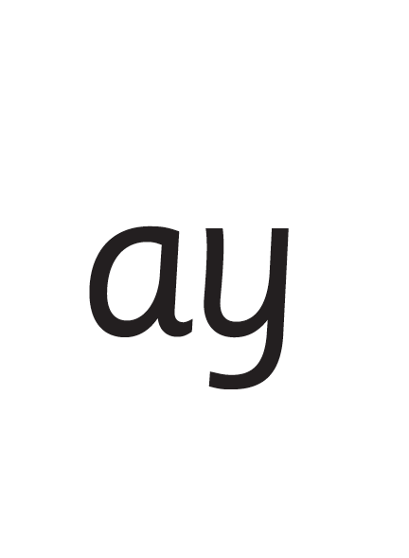
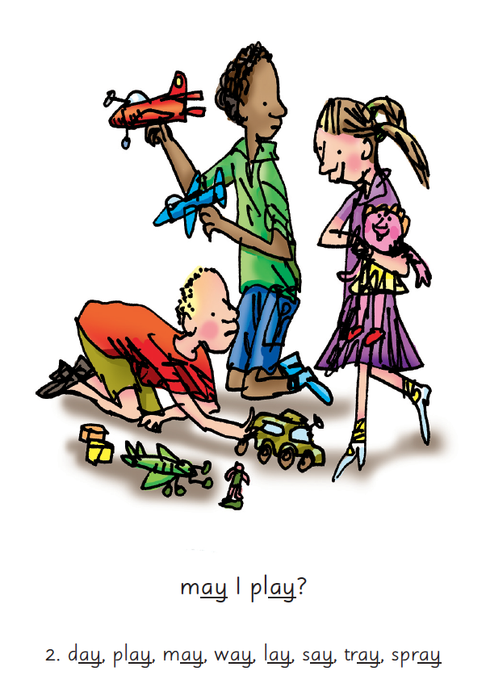

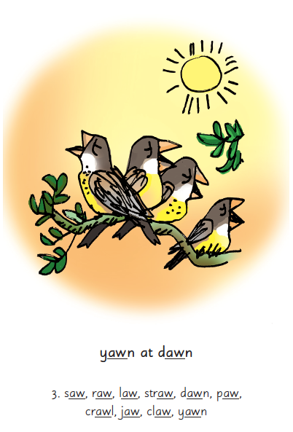
Picture Phrases
Notes:
We use picture phrases to help children remember the Set 2 and Set 3 sounds.
For example, ay, may I play? aw, yawn at dawn

Slide 8


Sounds + blending = reading
+
Notes:
Today I want to help you understand how your child is learning to read words in Read Write Inc. Phonics by blending sounds together:
Alongside teaching children sounds, we teach them to blend sounds to read words e.g. s-a-t, sat.
We use Fred Talk to help children read.

Slide 9




Reading with Fred Talk
Notes:
We teach children to read words using Fred Talk to blend together the sounds they know e.g. m-a-t, mat.
We say ‘Fred Talk, read the word’.

Slide 10
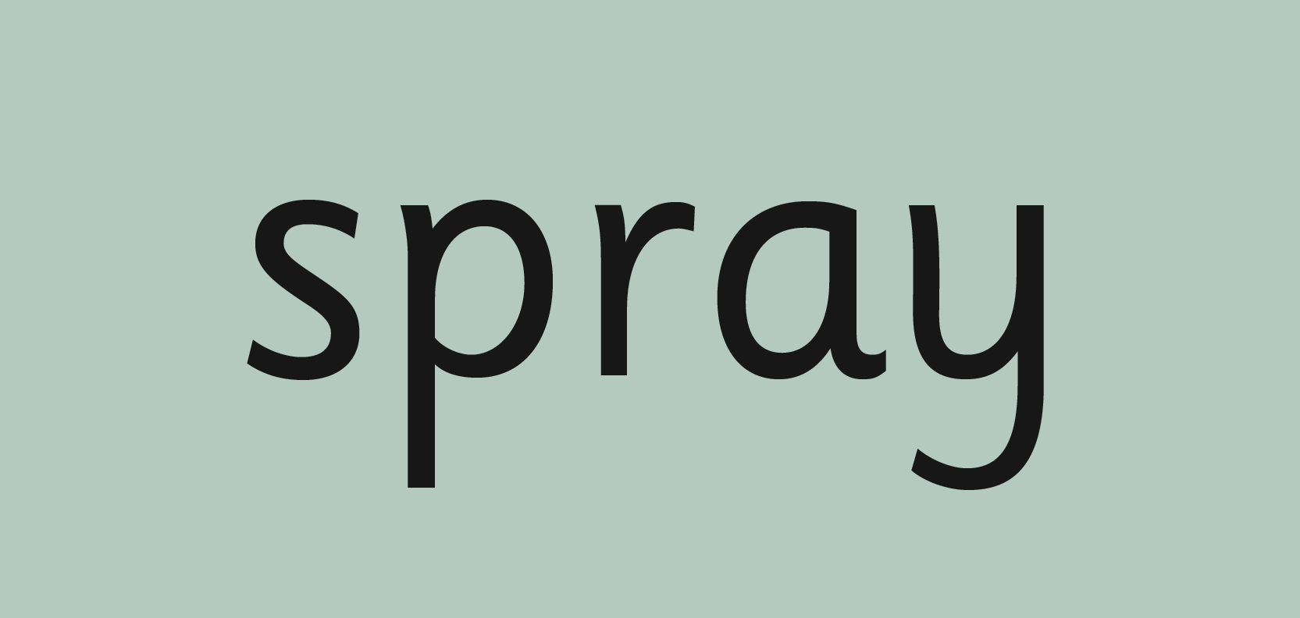

‘Special Friends’, ‘Fred Talk’, read the word
Notes:
Then children practise reading these sounds in words using the routine ‘Special Friends’, ‘Fred Talk’, read the word’.
They spot the ‘Special Friends’ first, then Fred Talk to read the word.
For example, ‘ay’, s-p-r-ay, spray.

Slide 11
Read Write Inc. Phonics
Parents’ Meeting
Listening to your child read
Notes:
Approximately 20 minutes is needed for this session.
Notes are provided to help you lead the presentation.
Notes in italics are for your attention only.
Provide copies of ‘Reading at Home Booklet 1 or 2’ from Oxford Owl.
Booklet 1 is sound groups and Ditty/ Red Groups and Booklet 2 for Green – Grey Storybooks.
Children will make the best possible progress if they read as often as possible.
Today we are going to discuss how to listen to your child read their Read Write Inc. Phonics decodable storybook when they bring it home.

Slide 12
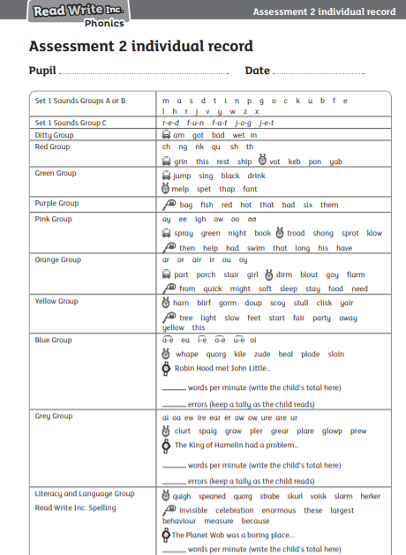
Your child is checked to see what level they are. This is bespoke and 1:1

Slide 13
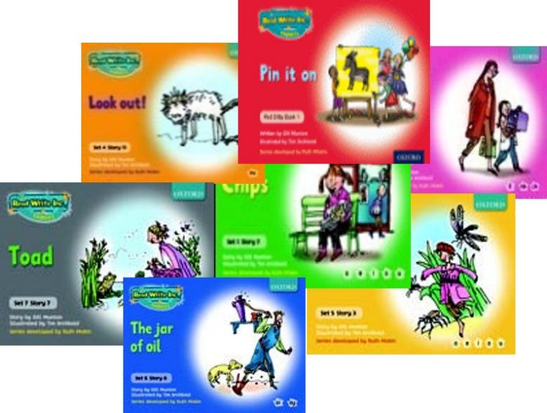
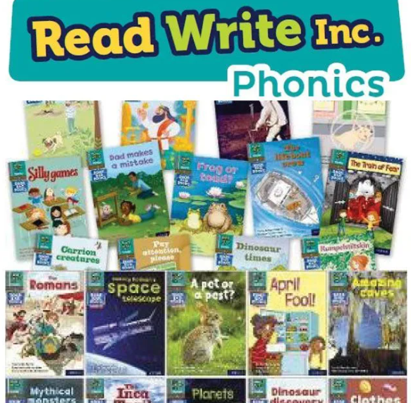

You may have the book a few days…
Notes:
So after the third read in class, children bring the same Storybook home in their book bag.
They love this book!
They can read it like a storyteller and can’t wait to read it to you, their grandparents or even their teddy bear.
Please avoid saying, “This book is too easy for you!” but instead say “I love how well you can read this book!”
They are meant to be able to read all of the words as the book is at the correct level.
Encourage them to share their enjoyment of the story with you and read it in their storyteller voice – again and again.

Slide 14


‘Special Friends’, ‘Fred Talk’, read the word
Notes:
E Children will be able to read all of the words in the Storybook.
If they hesitate, remind them to read the word using ‘Special Friends, Fred Talk, read the word’.
For example, this means they spot the ‘sh’, then Fred Talk and blend to read the word e.g. sh, sh-i-p, ship.

Slide 15

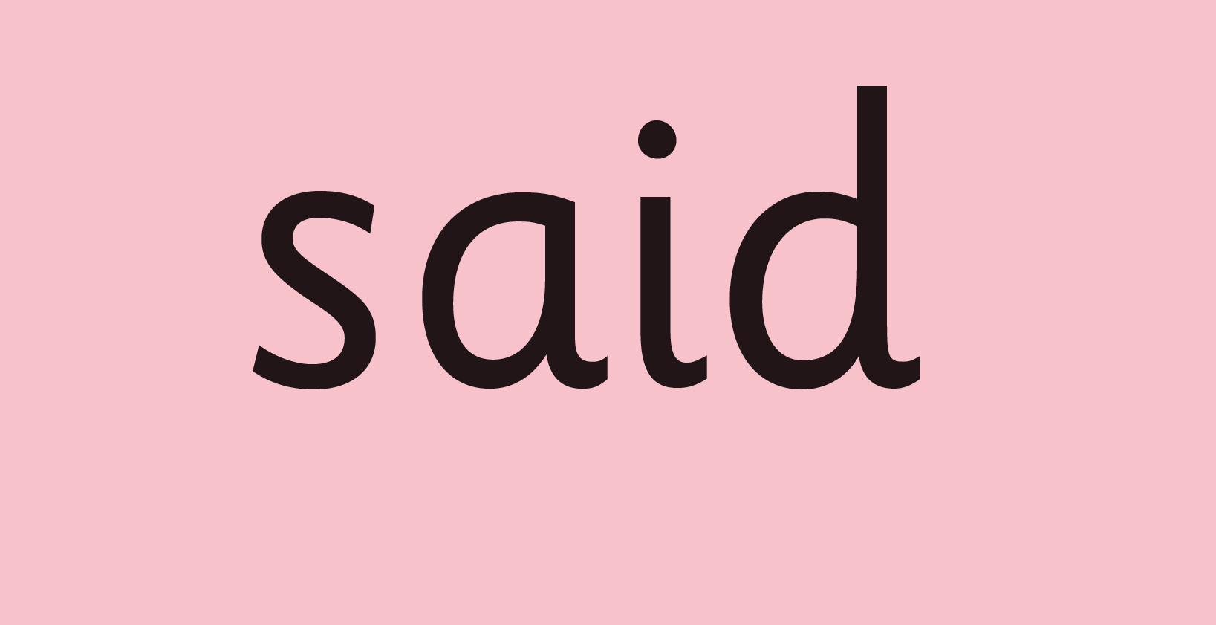
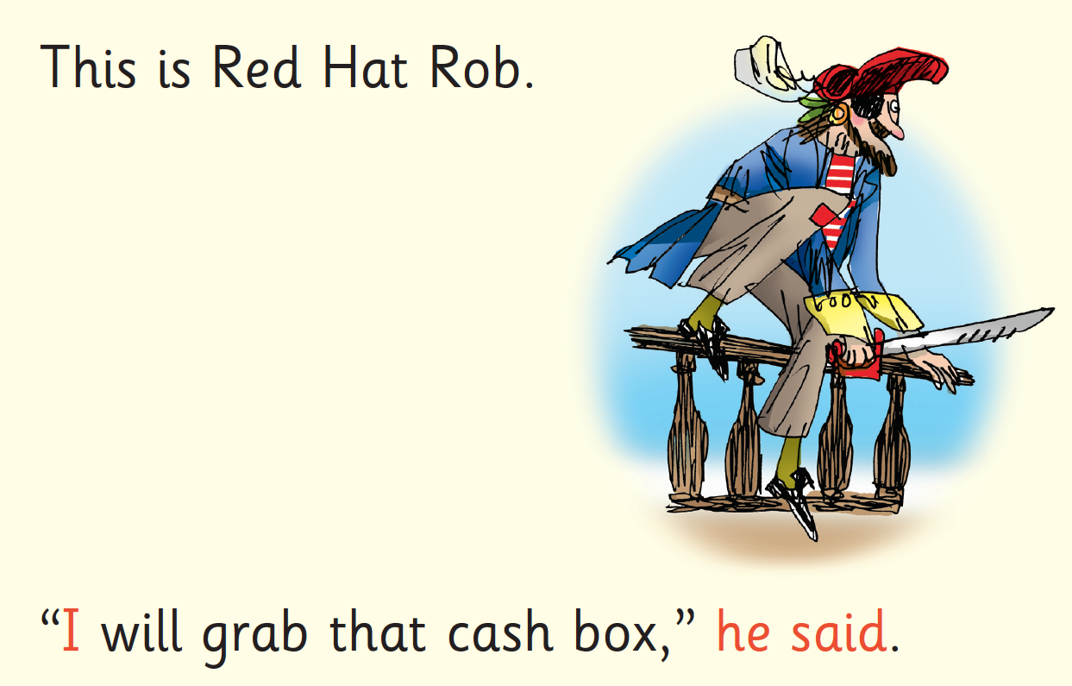
Red Words
Notes:
Some words are ‘tricky’ because they contain letters that don’t match the sounds the child has been taught.
For example, ‘said’ has ‘ai’ making an ‘e’ sound.
We teach these common exception words as Red words.
In the early Storybooks, these words are printed in red text.
Remind your child not to use Fred Talk to read Red words but instead to stop and think. Tell them the word if needed.

Slide 16
What can you do?
Listen to your child read the same Storybook again and again
Read with regular frequency
Encourage them to use ’Special Friends’, ‘Fred Talk’, ‘read the word’
Discuss the story and encourage their storyteller voice.
Share a varied range of books with your child and share story times with them.
Notes:
Provide copies of ‘Reading at Home Booklet 1 or 2’ from Oxford Owl.
Booklet 1 is sound groups and Ditty/ Red Groups and Booklet 2 for Green – Grey Storybooks.

Slide 17


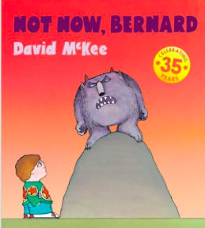

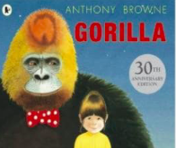
Repeated readings
Again! Again!
Children are wired to thrive on repetition
This is very different from when I was at school…
Notes:
Stories provide a wealth of language we don’t use in everyday talk.
The more stories, poems and nursery rhymes children know well, the more easily they will be able to understand what they read, when they can read.
Children thrive on repetition.
Take Sophie who is 2 ½ years old.
She begs for her favourite stories to be read over and over again.
The more her mum repeats the story, the more the story ‘belongs’ to Sophie.
Sophie ‘reads’ it, copying the special emphasis and actions that her mum used every time she read the story to her.

Slide 18
Top Tips - Storytime
Make it a treat
Make it a special quiet time
Show curiosity
Read story once without stopping
Chat about the story
Avoid testing with questions
Link to other stories and experiences
Read favourites over and over again
Use different voices
Love the book
Notes:
Here are our ten top tips for Storytime at home.
Make it a treat – introduce each new book with excitement.
Make it a special quiet time – cuddle up!
Show curiosity in what you’re going to read.
Read story once without stopping so they can enjoy the whole story. . If you think your child might not understand something say something like ‘Oh I think what’s happening here is that…”
Chat about the story e.g. I wonder why he did that? Oh no, I hope she’s not going to…
Avoid asking questions to test what they remember.
Link to other stories and experiences you have shared e.g. this reminds me of…
Read favourites over and over again – encourage your child to join with the bits they know. Avoid saying ‘not that story again!’
Use different voices – be enthusiastic!
Love the book – read with enjoyment.
I will give you a handout with these tips when you leave today.

Slide 19
Read Write Inc. Phonics
Parents’ Meeting –
Phonics Screening Check
Notes:
Approximately 10 minutes is needed for this session.
Notes are provided to help you lead the presentation.
Notes in italics are for your attention only.

Slide 20
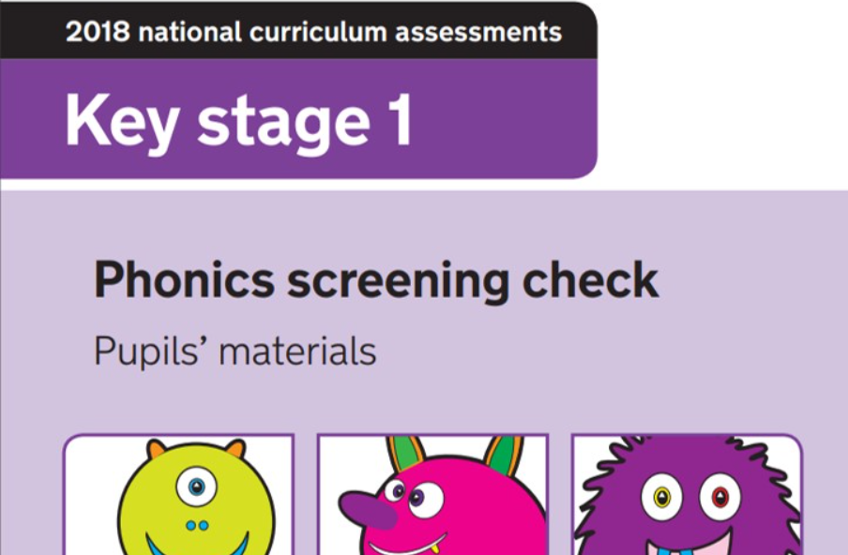
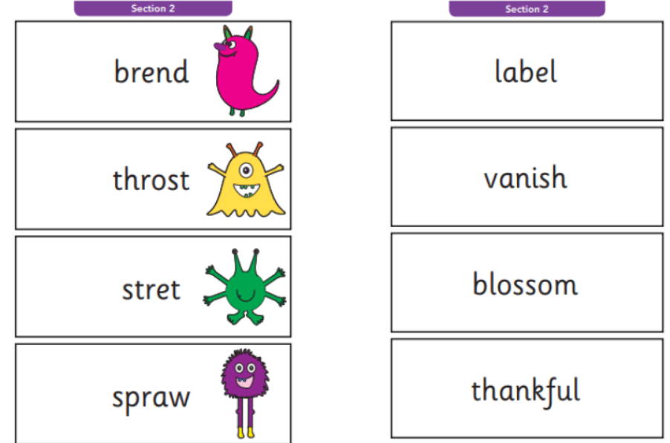
What is the Phonics Screening Check?
A word-reading test at the end of Year 1
Children read 40 words
20 real words
20 pseudo words (alien words)
Notes:
Children complete a word-reading check at the end of Year 1 so that parents can be confident their children are being taught to read successfully.
Children read 40 words. It takes between two and five minutes.
If they do not manage to read 32 of the words, they are given extra support, and repeat the check at the end of Year 2.
It means that all children will be able to read accurately before they begin Year 3.
In our school, we aim to make sure that every child learns to read accurately by the end of Year 1 so they are set up for success in school and in life.
As soon as we spot a child who needs extra practice learning to read sounds and words, we teach them one-to-one for a few minutes every day.

Slide 21
‘Special Friends’, ‘Fred Talk’, read the word
Notes:
We teach children to read both real and nonsense words using the routine ‘Special Friends’, ‘Fred Talk’, read the word’.
Children spot the ‘Special Friends’ (two letters that make one sound), Fred talk the word, and then read the word as a whole.
For example, ‘sh’, sh-i-p, ship.

Slide 22




Nonsense words
Notes:
Half of the words in the check are real words.
Half are nonsense words. For example, ‘sheb’, ‘glight’, ‘ched’, ‘teb’.
There is a picture of an alien next to each word to remind the children that it isn’t a real word.
Nonsense words check that children will be able to read sounds they know in unfamiliar words.
Children who can read nonsense words will, very soon, be able to read any new word – for example – gargantuan, flailing, raucous, anticipation;
Reading new words increases children’s vocabulary rapidly.

Slide 23
Testing window…
This years testing window starts the week beginning Monday 10th June 2024
It can happen any time during that week
Please try to ensure your child is at school during this week
Once the window is closed your child will have missed the opportunity and will have to be tested again in Year 2

Slide 24
Why Year 1?
It is not a reading test!
Every Year 1 child in the country will be taking the statutory phonics screening check in June.
The children are used to doing these as we have already completed practice tests at each assessment point this year.
The focus of the check is to determine if individual children have the sufficient phonic decoding and blending skills to meet the appropriate standard.

Slide 25
How will it be administered?
Teachers will conduct all of the screening checks with the children. The children are familiar with this routine.
The children will complete the check one to one in a quiet area of the school.
We are not permitted to indicate to the children at the time whether they have correctly sounded out and/or blended the word.
Praise and encouragement throughout is given.

Slide 26
And the results...?
The children will be scored against a national standard (determined by DfE)
We will inform you of the results during the summer term as part of their annual school report.
If your child’s score falls below the national standard they will be supported and will complete the screening in Year 2.

Slide 27
Online resources available
Ruth Miskin Parents’ Page:
http://www.ruthmiskin.com/en/parents/
Ruth Miskin Facebook:
https://www.facebook.com/miskin.education
Free e-books for home reading:
http://www.oxfordowl.co.uk/Reading/

Slide 28
Reading changes everything…
“Teach a child to read and keep that child reading and we will change everything.
And I mean everything.”
Jeanette Winterson
Notes:
Today I want to help you understand more about the Phonics Screening Check – a word reading test that all Year 1s undertake in June.
Accurate word-reading at six is a good predictor of future reading success.
In December 2018, research found that nearly 90% of children who passed the phonics check taken in Year 1 reached or exceeded the expected standard in reading in Year 6.

Slide 29
Any other questions? Thank you for listening…
Q&A

